Slide 1
InstalLation

Slide 2
agenda
Meaning & Types of Installation of operating system.
MBR & GPT
Components of installations.
CLI & GUI
Terminals & Shell
Commands & Commands Structure.

Slide 3
Meaning & Type of Installation
Installation is the act of making the program ready for executions.
Installation means load files in your system acc to architecture of operating system.
Bare Metal Installation.
Virtual Machine Installations.
Installation on Cloud Providers.

Slide 4
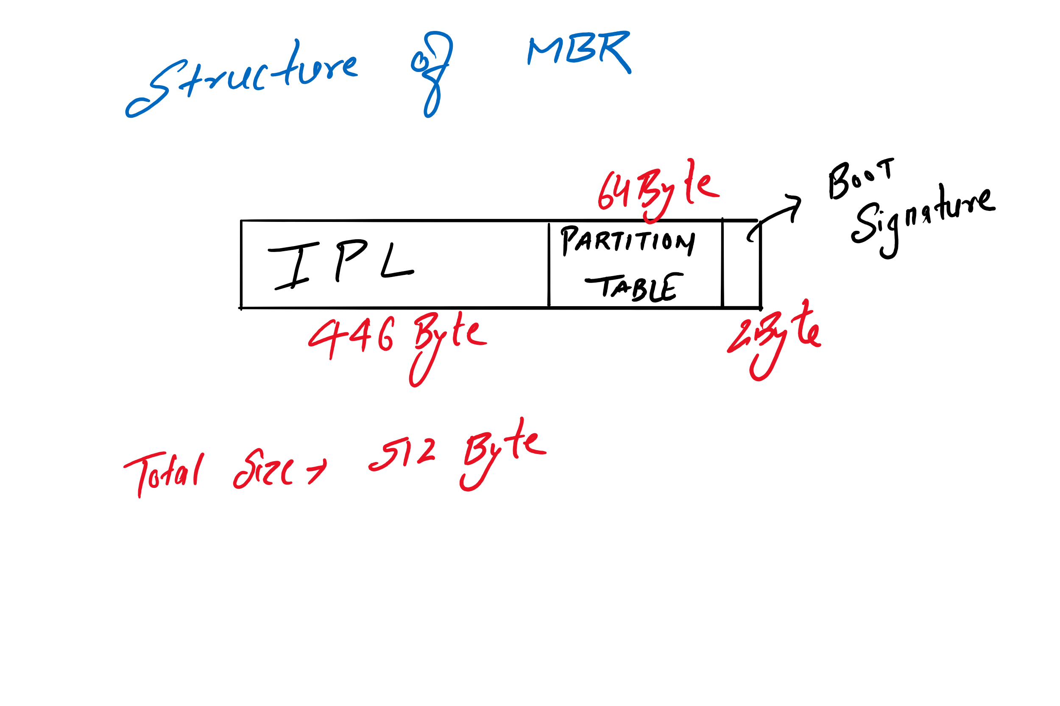
MBR (Master BOOt Record)

Slide 5
MBR & GPT Partition schemes
MBR works with disks up to 2 TB in size.
MBR also only supports up to four primary partitions.
GPT allows for a nearly unlimited amount of partitions.
GPT stores multiple copies of this data across the disk

Slide 6
Components of Installation
BIOS Priority.
Partitions Size & Uses.
KDUMP
Partition Types
Network & hostname.
Types of Server

Slide 7
CLI & GUI
Command Line Interface, is a text-based interface.
Graphical User Interface, is a visual-based interface.
GUI have limitation in term of CLI.
A GUI needs to use additional system resources to load the graphical part thus it is going to be slower than using the command line.
GUI do not readily support scripting or automation.
For less memory usage we use CLI

Slide 8
SheLL
Shell is an interface between user & kernel.
Every operating system have its own shell
Linux(Bourne Again Shell (BASH))
UNIX(Bourne Shell(SH))
WINDOWS(powershell)

Slide 9
Commands & commands structure
Command is a set of instruction given by user on terminals.
Command options argument
rm –f gaurav.txt.
man command
Pinfo command
Ctrl+C , Ctrl+D , Ctrl+L

